Slide 1

TN COIN DELIVERY PROCESS

Slide 2
INFORMATION REQUIRED
S No | Info Type | Info Description
1 | Address Information | Door/House Number
2 |  | Building Name or Number / Apartment Name / Plot Number
3 |  | Street Name / Road
4 |  | Area / Locality
5 |  | Landmark
6 |  | Village / Taluk
7 |  | City / Town
8 |  | District
9 |  | Pincode (6 digits)
10 | Receiver Information | Receiver Name
11 |  | Primary Mobile Number (10-digit): (For delivery coordination and OTP verification)
12 |  | Alternate Mobile Number (10-digit): (Only for backup coordination; no OTP will be sent here)
13 |  | Identity Verification: [Last 4 digits of Aadhaar Number]

Slide 3
LAST MILE DELIVERY PROCESS
Sequel’s Call Centre will call the recipient and take confirmation for delivery
Reach the Address and Meet the Recipient at the provided Address
Sequel Logistics Delivery Person will perform the following check on the Mob App:
Check 1 : Last 4 Digit Aadhar number authentication
Check 2 : Mobile OTP authentication
Check 3 : Voucher number authentication
If the above 3 checks are found ok, the
Capture & Tag the Coin number (QR / Bar Code number) in the Mob App
Take the signature of the recipient on the Docket (Proof of Delivery), and take the image
Handover the Gold coin to the recipient
Take picture of the recipient along with the product
Conclude the delivery

Slide 4
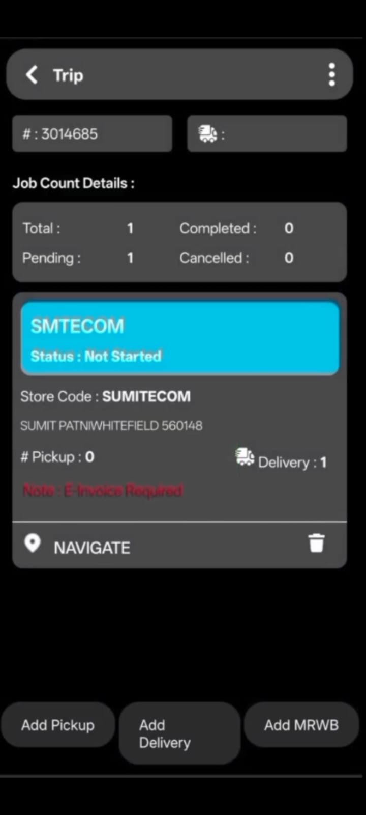
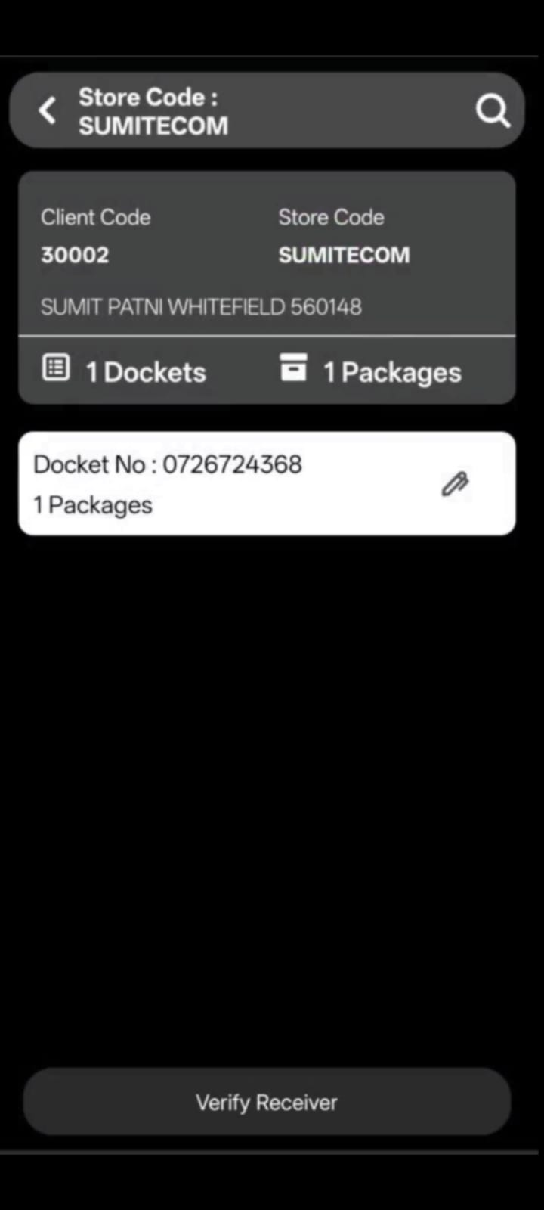
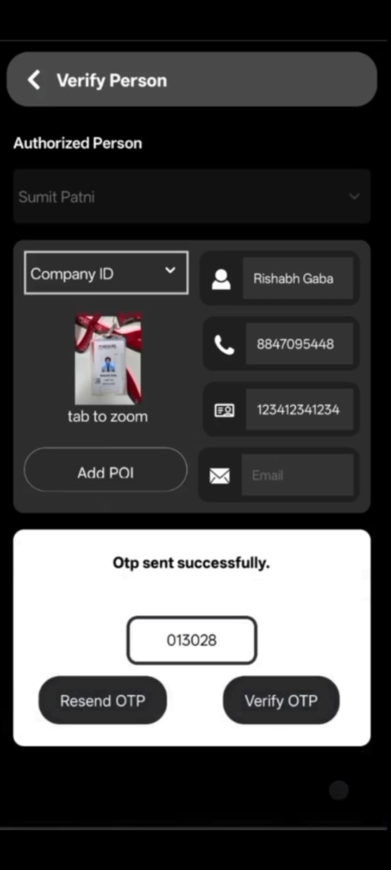
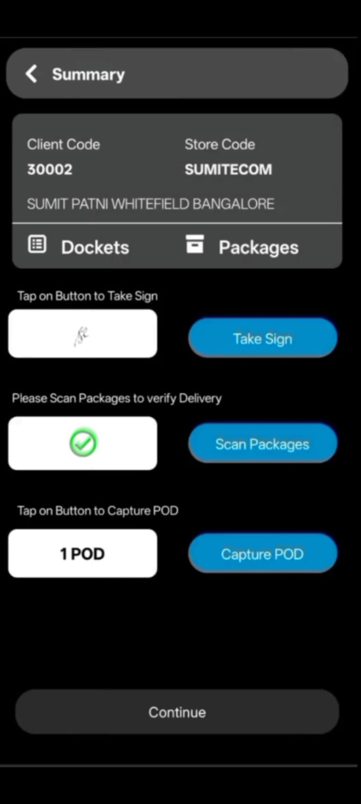
LAST MILE:
Selection of Address Card with Geofencing
Selection of Job Card - Docket
Dual Step Verification of Receiver (OTP+ Proof of Identity)
Getting Authorised Signature Validation of Package POD(Proof of Delivery) Capture

Slide 5
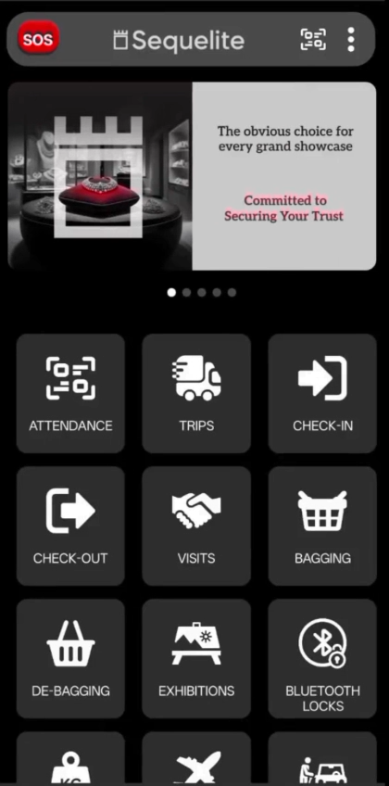
LAST MILE:
DELIVERY PROCESS

Slide 6
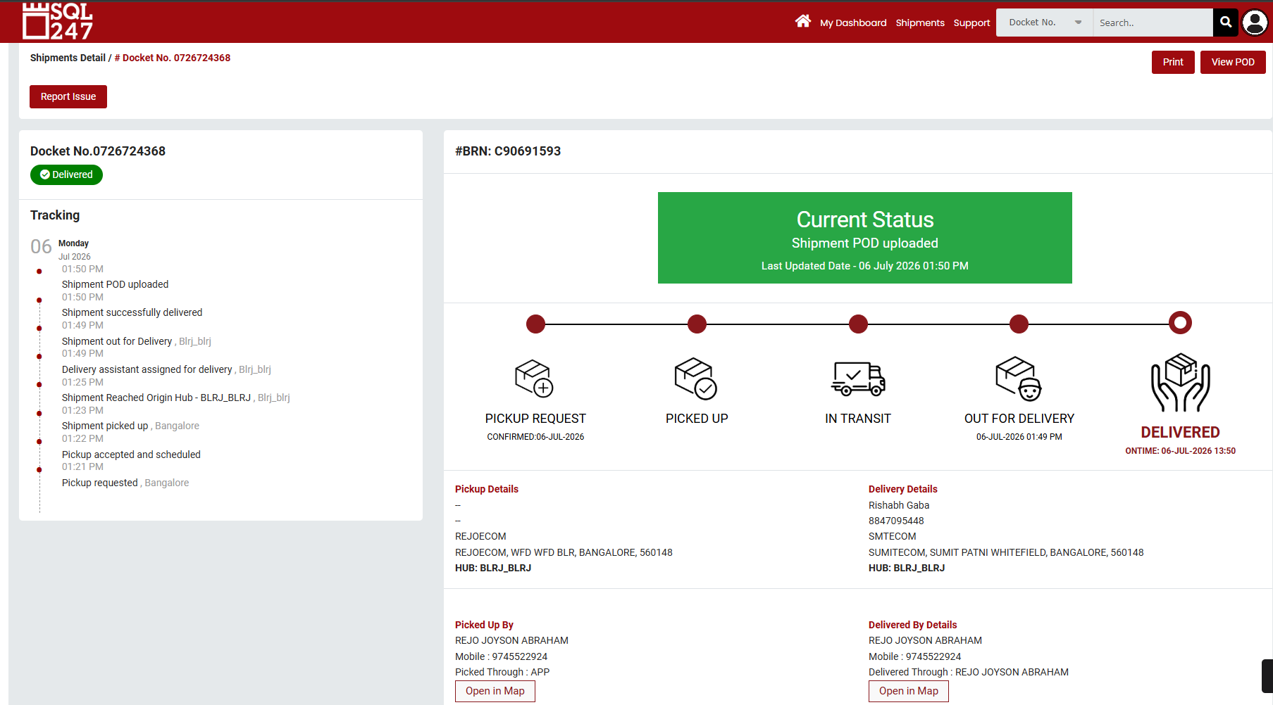
Track & Trace
Click Here to see Coordinates

Slide 7
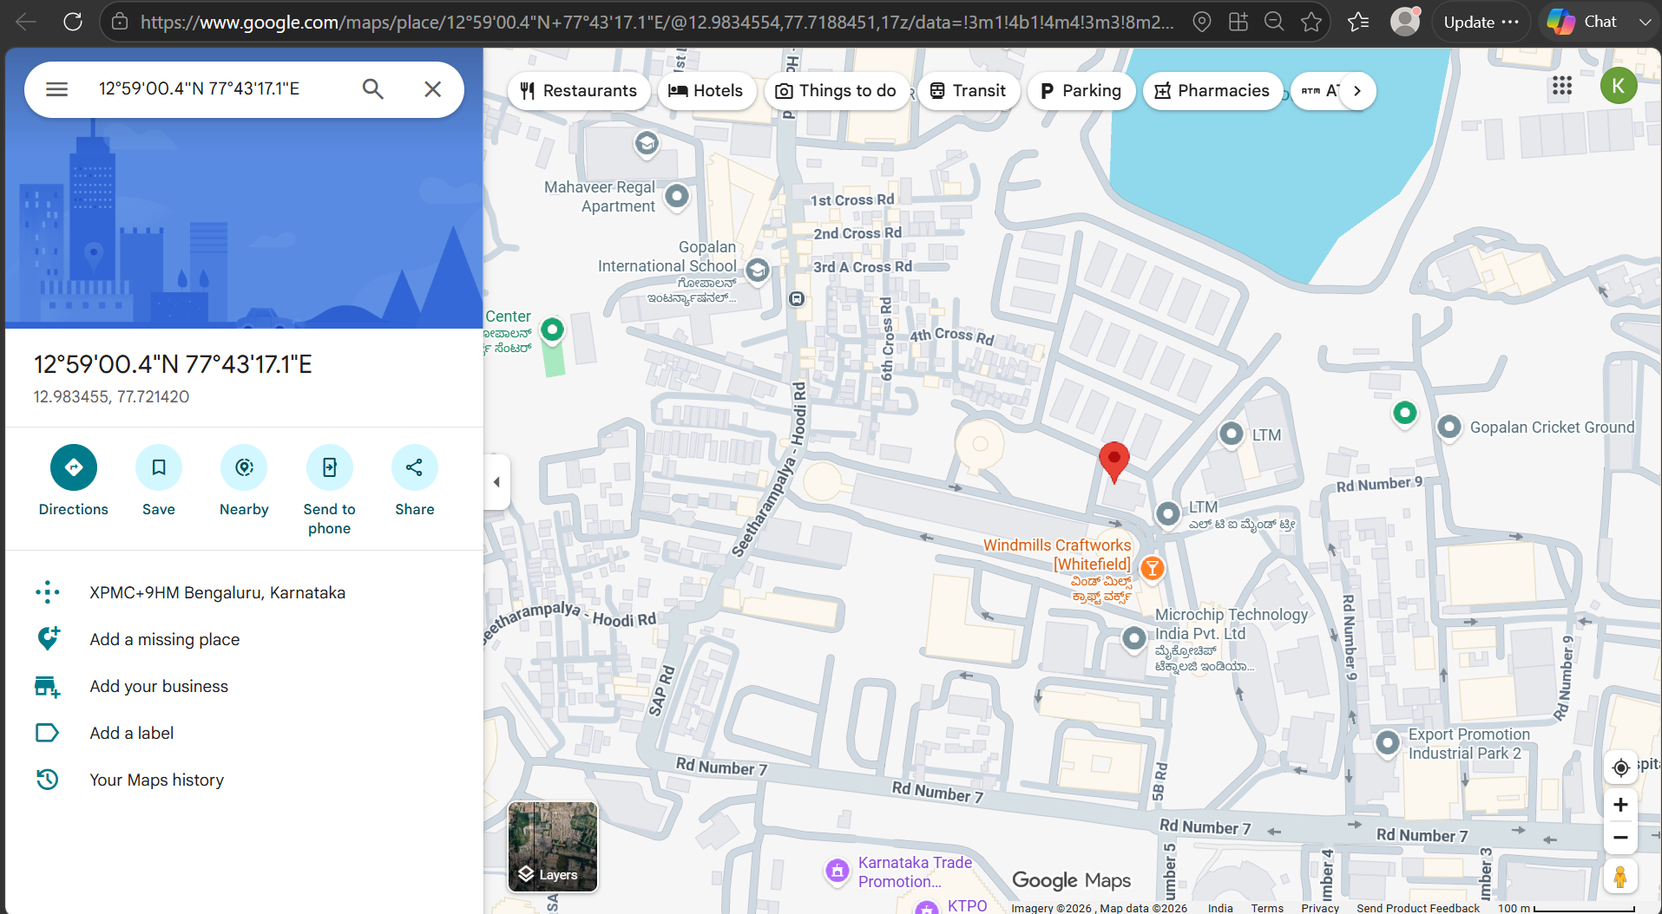

Slide 8
THANK YOU

